Slide 1
Why Massachusetts Students Need Personal Finance as a Graduation Requirement
Presentation to Massachusetts Bankers Association
Mary Anne Clancy Retired SVP Marketing & Communication Institute for Savings
Julie Beckham AVP Financial Education Development & Strategy Rockland Trust Bank

Slide 2
What is the Financial Empowerment Network (FEN) What is the Student Financial Education Initiative (SFEI)
A Massachusetts-based statewide coalition founded in 2008 of educators, nonprofits, community organizations, banks, credit unions, and individuals united to advance financial literacy across Massachusetts.
Student Financial Education Initiative is a nonprofit that oversees the www.creditforlife.org education technology program designed to support Credit for Life and Reality Fairs.

Slide 3
The Problem: Access to Financial Education is Inequitable!
Financial literacy is taught inconsistently across MA school districts—some students graduate prepared, others do not.
As of 2025, only 20 of 475 MA public high schools make personal finance a graduation requirement

Slide 4
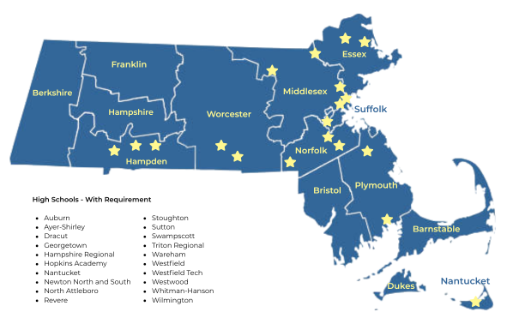
MA School Districts That Offer A Stand-Alone Personal Finance Course

Slide 5
2025 Massachusetts K-12 Graduation Council Statewide Survey
93% of survey respondents said they want high school graduates to complete a personal finance course before graduating.
Personal finance as a requirement ranked higher than any other coursework area, consistent across all economic, social, geographic and racial demographics

Slide 6
Groups and Individuals Who Submitted Testimony and/or Have Expressed Support for a Comprehensive Financial Education Requirement
Massachusetts Financial Educators Council
Massachusetts Association of Student Representatives (MASR)
FitMoney
Junior Achievement
WellFin 360
MA Council for Economic Education
Mass Law
More than 50 individuals including financial advocacy experts Dr. DeShawn Washington,2024 MA Teacher of the Year; and Yanely Espinal, author and director of Educational Outreach at Nex Gen Personal Finance
MA Bankers Association and its 120 members – THANK YOU!
The Midas Collaborative
MA Association of School Committees
Women’s Money Matters
Nex Gen Personal Finance
MA Society of Certified Public Accountants (MassCPAs)
Massachusetts Jump$tart Coalition
Student Financial Education Initiative

Slide 7
What the 2025 K-12 Statewide Graduation Council Interim Report Says
The Graduation Council identifies financial literacy as a core graduation competency.
It suggests flexible delivery: a stand‑alone course, embedded instruction, or approved experiential learning.

Slide 8
Pending Massachusetts Legislation
H.4670 passed the Massachusetts House unanimously (155–0) on Oct. 29, 2025.
It was read in the Senate and referred to Senate Ways & Means on Oct. 30, 2025.
Bill establishes a Financial Literacy Trust Fund and requires personal financial literacy instruction (middle/high school)

Slide 9
The Problem with H. 4670?
It does NOT require a stand‑alone course (.5 credits or equivalent) before graduation.

Slide 10
A Stand-Alone Course Reflects the Realties of Today’s World
Today’s students face financial decisions earlier and with higher stakes than previous generations
Student loans and credit access
Digital banking and payment apps
Online/sports gambling
Online scams and identity theft
Rising costs of housing, healthcare and education
A statewide requirement acknowledges that financial literacy is no longer optional.

Slide 11
Stand Together for a Stand-Alone Semester It is the GOLD Standard!
Guarantees equitable access for every student
Creates depth, not just exposure
Aligns with real life decision timing
Easier to measure and improve
Research proves it is the best model and national best practice
Signals importance to students and sets them up for lifelong success

Slide 12
What’s Next
K–12 Statewide Graduation Requirement Council
Interim Report issued December 2025 “Reimagining High School, Reimagining Readiness” that included an initial recommendation to include financial literacy
Next steps:
Final recommendations due June 2026
New statewide graduation requirement to be enacted
Regulations to be developed by DESE
Legislative action tied directly to the Council’s final framework
MA Legislature
House: passed H. 4670 that does NOT include a stand-alone requirement
Senate: S. 2988 is in Ways & Means Committee and includes a full-semester standalone course.

Slide 13
“Stand Together for a Stand-Alone Semester” It is the GOLD Standard!
Guarantees equitable access for every student
Creates depth, not just exposure
Aligns with real life decision timing
Easier to measure and improve
Research proves it is the best model and national best practice
Signals importance to students and sets them up for lifelong success
To join the advocacy, please email Julie.Beckham@RocklandTrust.com

Slide 14
John Pelletier
Director
Center for Financial Literacy at
Champlain College

Slide 15
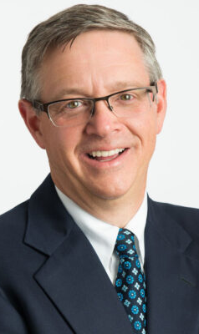
John Pelletier has served as the Director of the Center for Financial Literacy at Champlain College in Burlington, Vermont, since 2010.
A nationally recognized expert in personal finance education and legislation, he leads initiatives focused on improving financial literacy, including creating the 2023 National Report Card on High School Financial Literacy…which graded Massachusetts F in providing financial education resources in its public schools.

Slide 16
Q&A

